Slide 1
CyberSecurity Issue in Digital Library Context
Irhamni
University of North Texas
Jakarta, 11 Desember 2020

Slide 2
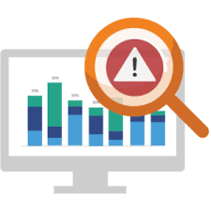
- Introduction
- Concept Map
- 5S Digital Library Framework
- Methodology

Slide 3
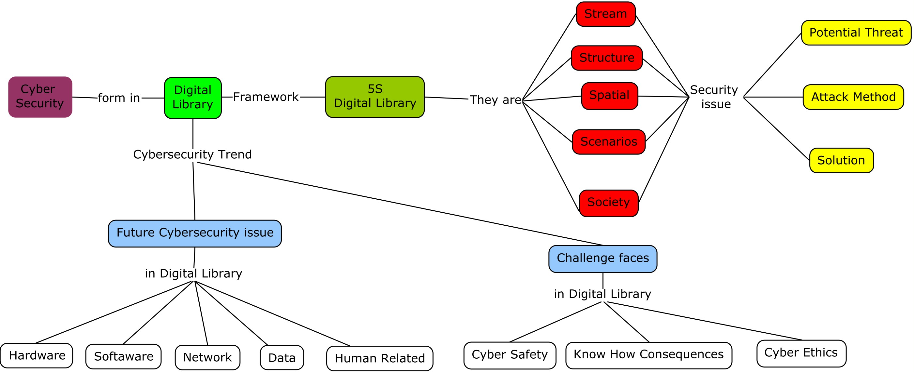
CONCEPT MAP

Slide 4
5S DIGITAL LIBRARY FRAMEWORK CONCEPT
Streams are sequences of arbitrary types (e.g., bits, characters, pixels, frames) and may be static or dynamic (such as audio and video).
A structure specifies the way in which parts of a whole are arranged or organized
A space is a set of objects together with operations on those objects that obey certain constraints. Spaces define logical and presentational views of several DL components, and can be of type measurable, measure, probability, topological, metric, or vector space.
A scenario is a sequence of events that also can have a number of parameters. Events represent changes in computational states; parameters represent specific variables defining a state and their respective values
A society is “a set of entities and the relationships between them” and can include both human users of a system as well as automatic software entities which have a certain role in system operation.
Murthy, U., Gorton, D., da S. Torres, R., Gonçalves, M. A., Fox, E. A., & Delcambre, L. (2007).
Sources : http://dlrl.cc.vt.edu/projects/5S-Model/

Slide 5
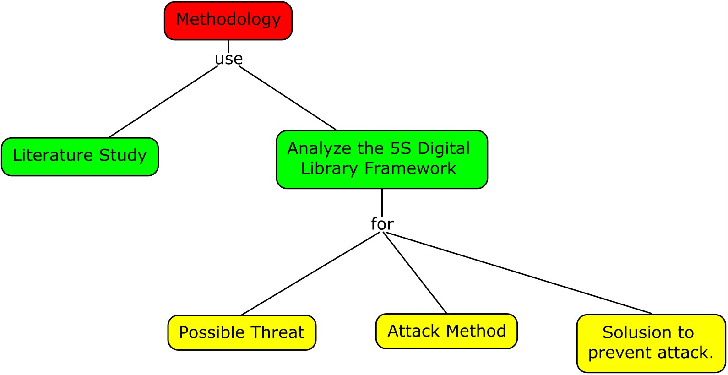
METHODOLOGY
Literature Study on security threat on 5S digital library framework
Analyze the 5S Digital Library Framework with Possible Threat, Attack Method and Solusion to prevent attack.

Slide 6
FINDINGS

Slide 7
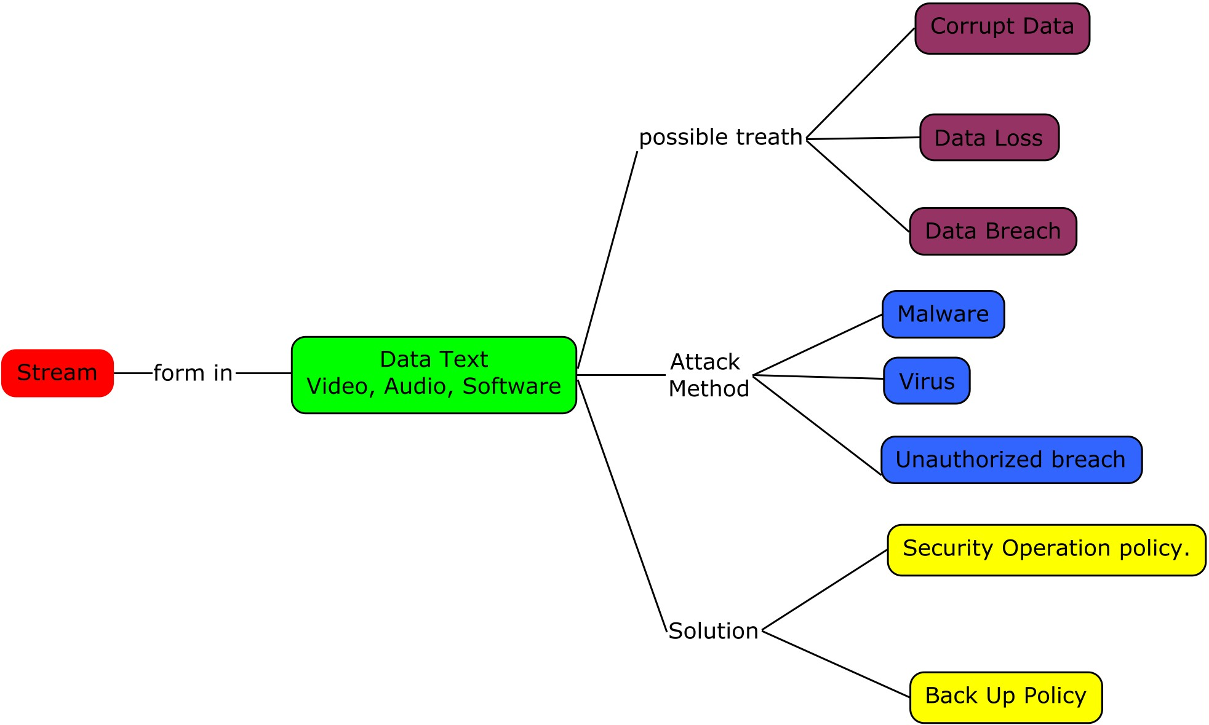
Findings on Stream Models
Models | Primitives | Formalisms | Objectives | Possible Threath | Attack Method | Solution
Stream Model | Text; video; audio; software program | Sequences; types | Describes properties of the Digital Library content such as encoding and langauge for textual material or particular forms of multimedia data | Corrupt Data, Data Loss | Malwares, Viruses | Security Operation policy, Back up Policy.

Slide 8
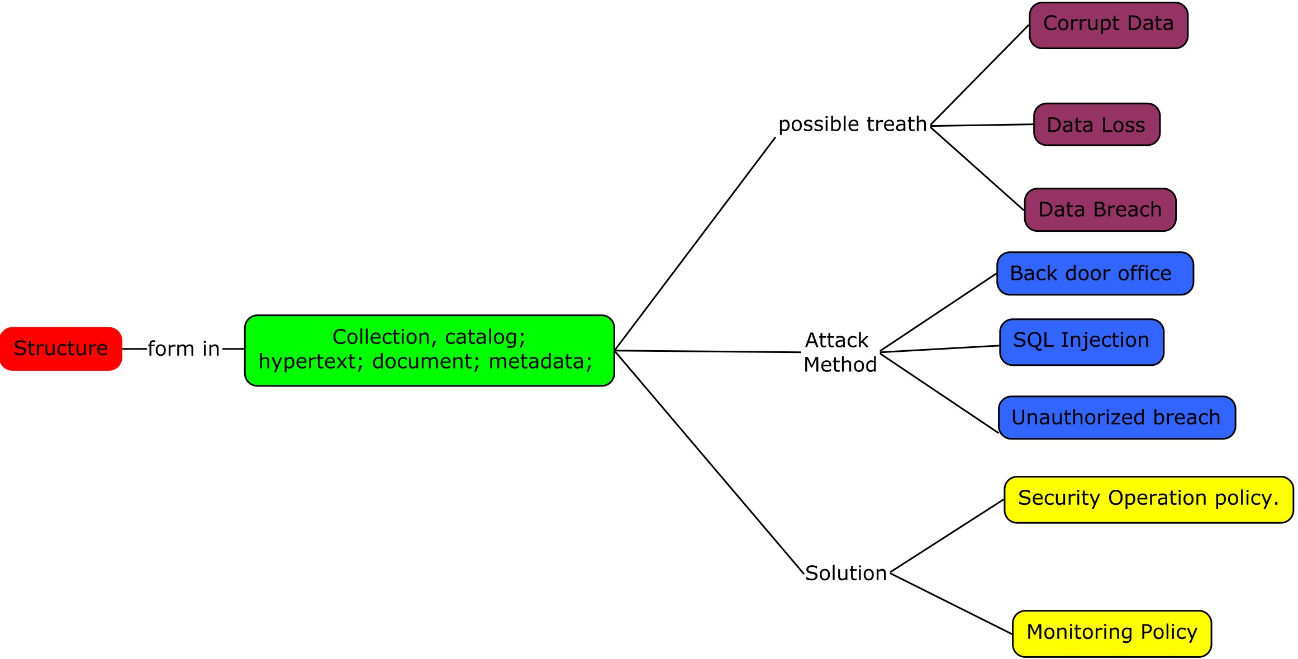
Findings on Structure Models
Models | Primitives | Formalisms | Objectives | Possible Threath | Attack Method | Solution
Structural Model | structure.jpgorganizational tools | Graphs; nodes; links; labels; hierarchies | Specifies organizational aspects of the Digital Library content | Corrupt Data, Data Loss | Unauthorized Access, Back door office, SQL Injection | Security and Monitoring Policy, Security Audit

Slide 9
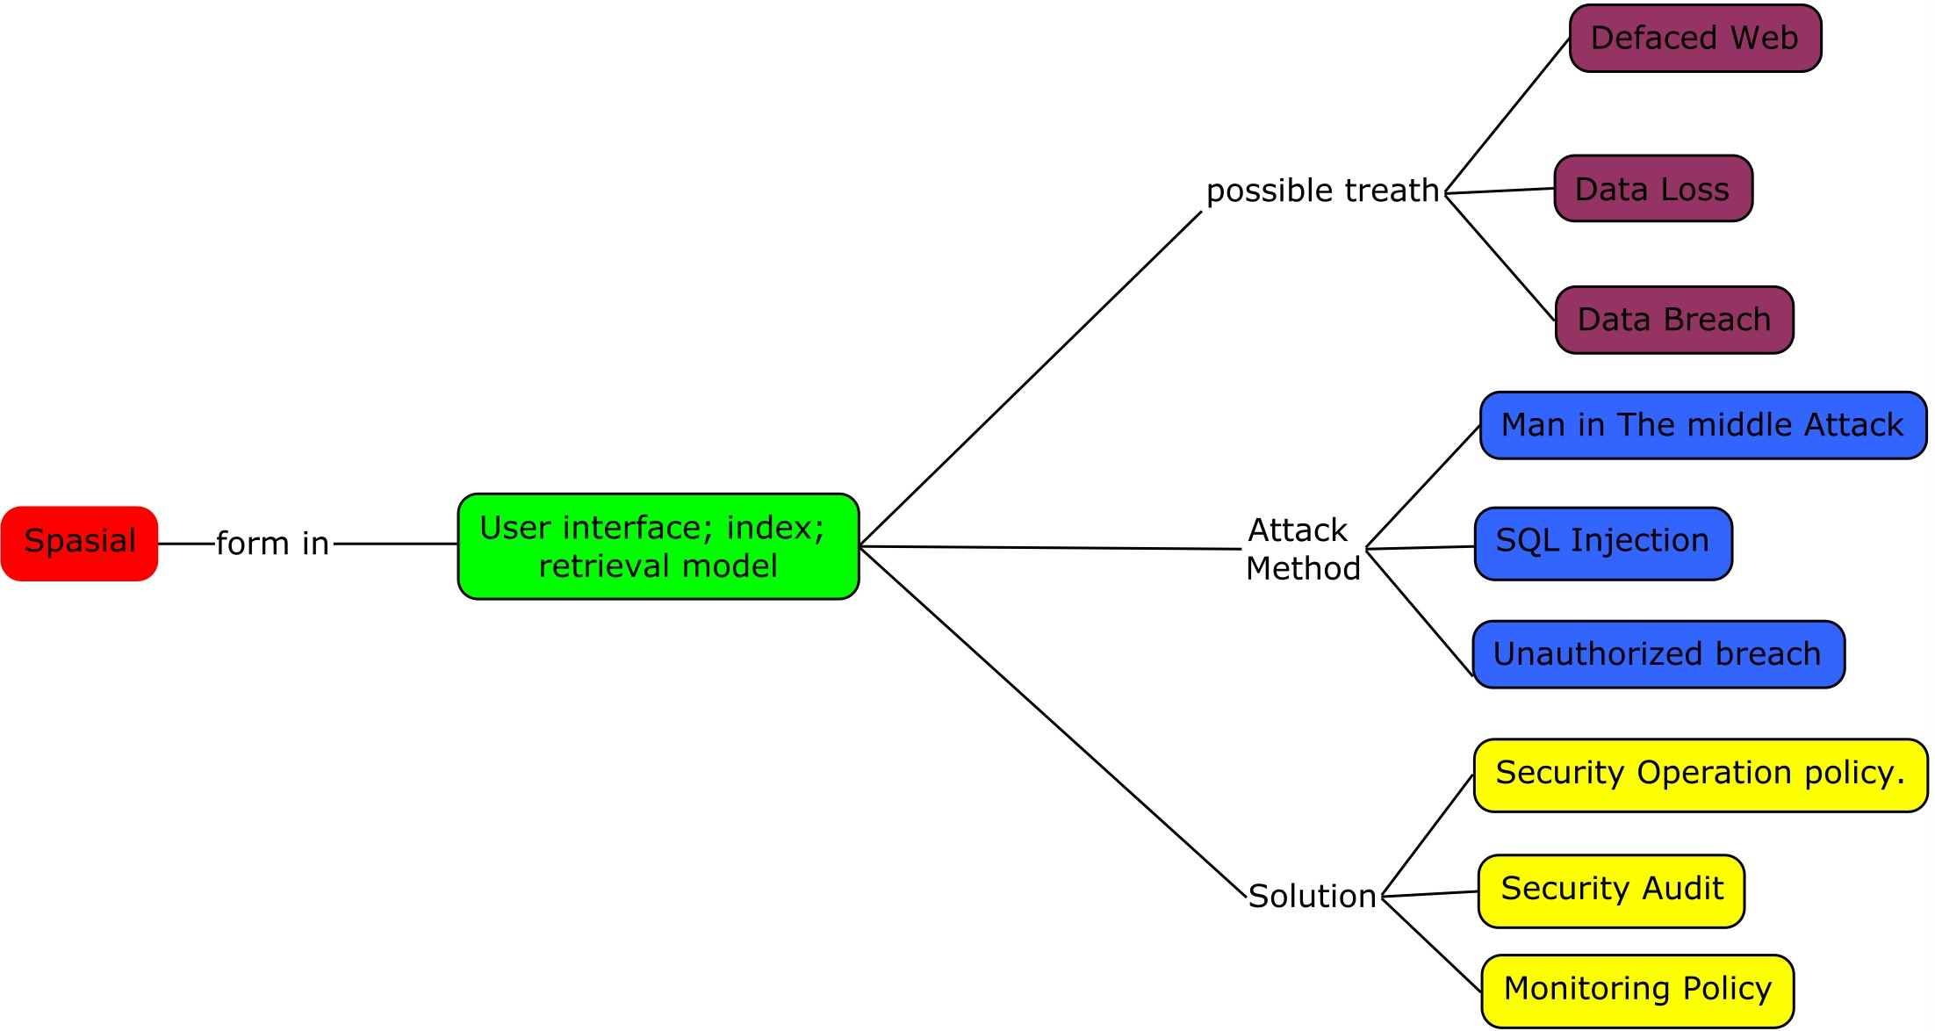
Findings on Spatial Models
Models | Primitives | Formalisms | Objectives | Possible Threath | Attack Method | Solution
Spatial Model | User interface; index; retrieval model | Sets; operations; vector space; measure space; probability space | Defines logical and presentational views of several Digital Library components | Defaced Interface, Data Loss | Unauthorized Access, | Security and Monitoring Policy, Security Audit

Slide 10
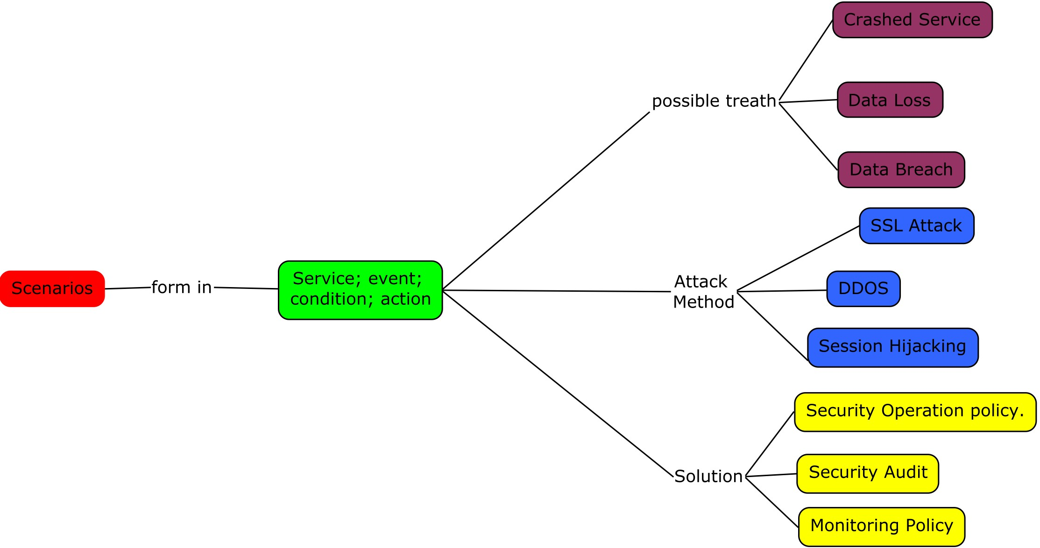
Findings on Scenario Models
Models | Primitives | Formalisms | Objectives | Possible Threath | Attack Method | Solution
Scenarios Model | Service; event; condition; action | Sequence diagrams; collaboration diagrams; | Details the behavior of Digital Library services | Data Breach, Data Loss Service Crashed | Session hijacking attack Denial of service attack (DDOS), SSL attack | Security and Monitoring Policy

Slide 11
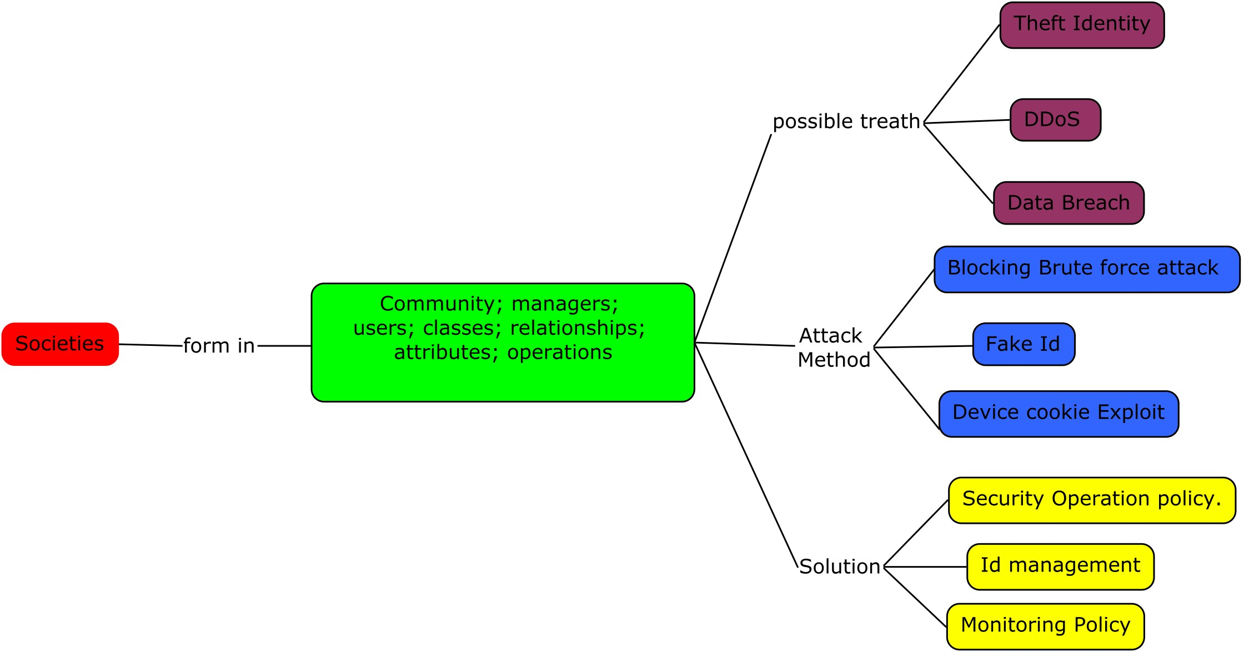
Findings on Society Models
Models | Primitives | Formalisms | Objectives | Possible Threath | Attack Method | Solution
Societies Model | Community; managers; users; classes; relationships; attributes; operations | Object-oriented modeling constructs; design patterns | Defines managers; responsible for running Digital Library services; actors, that use those services; and relationships among them | Data Breaching, Denial of service attack (DDOS), Theft Identity | Blockng Brute Force Attack, Device Cookies exploit, Fake ID | Security operation Policy Id Management policy, Monitoring policy

Slide 12
Discussion

Slide 13
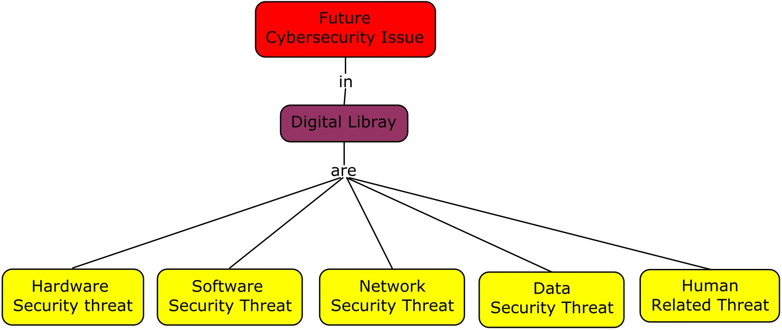
Future Cybersecurity Issue in Digital Library
There are several future cybersecurity issue in Digital Library, they are Hardware Security Threats, Software Security Threats, Network Security Threats, Data Security Threats, Human Related Threats (Adjie, 2019)

Slide 14
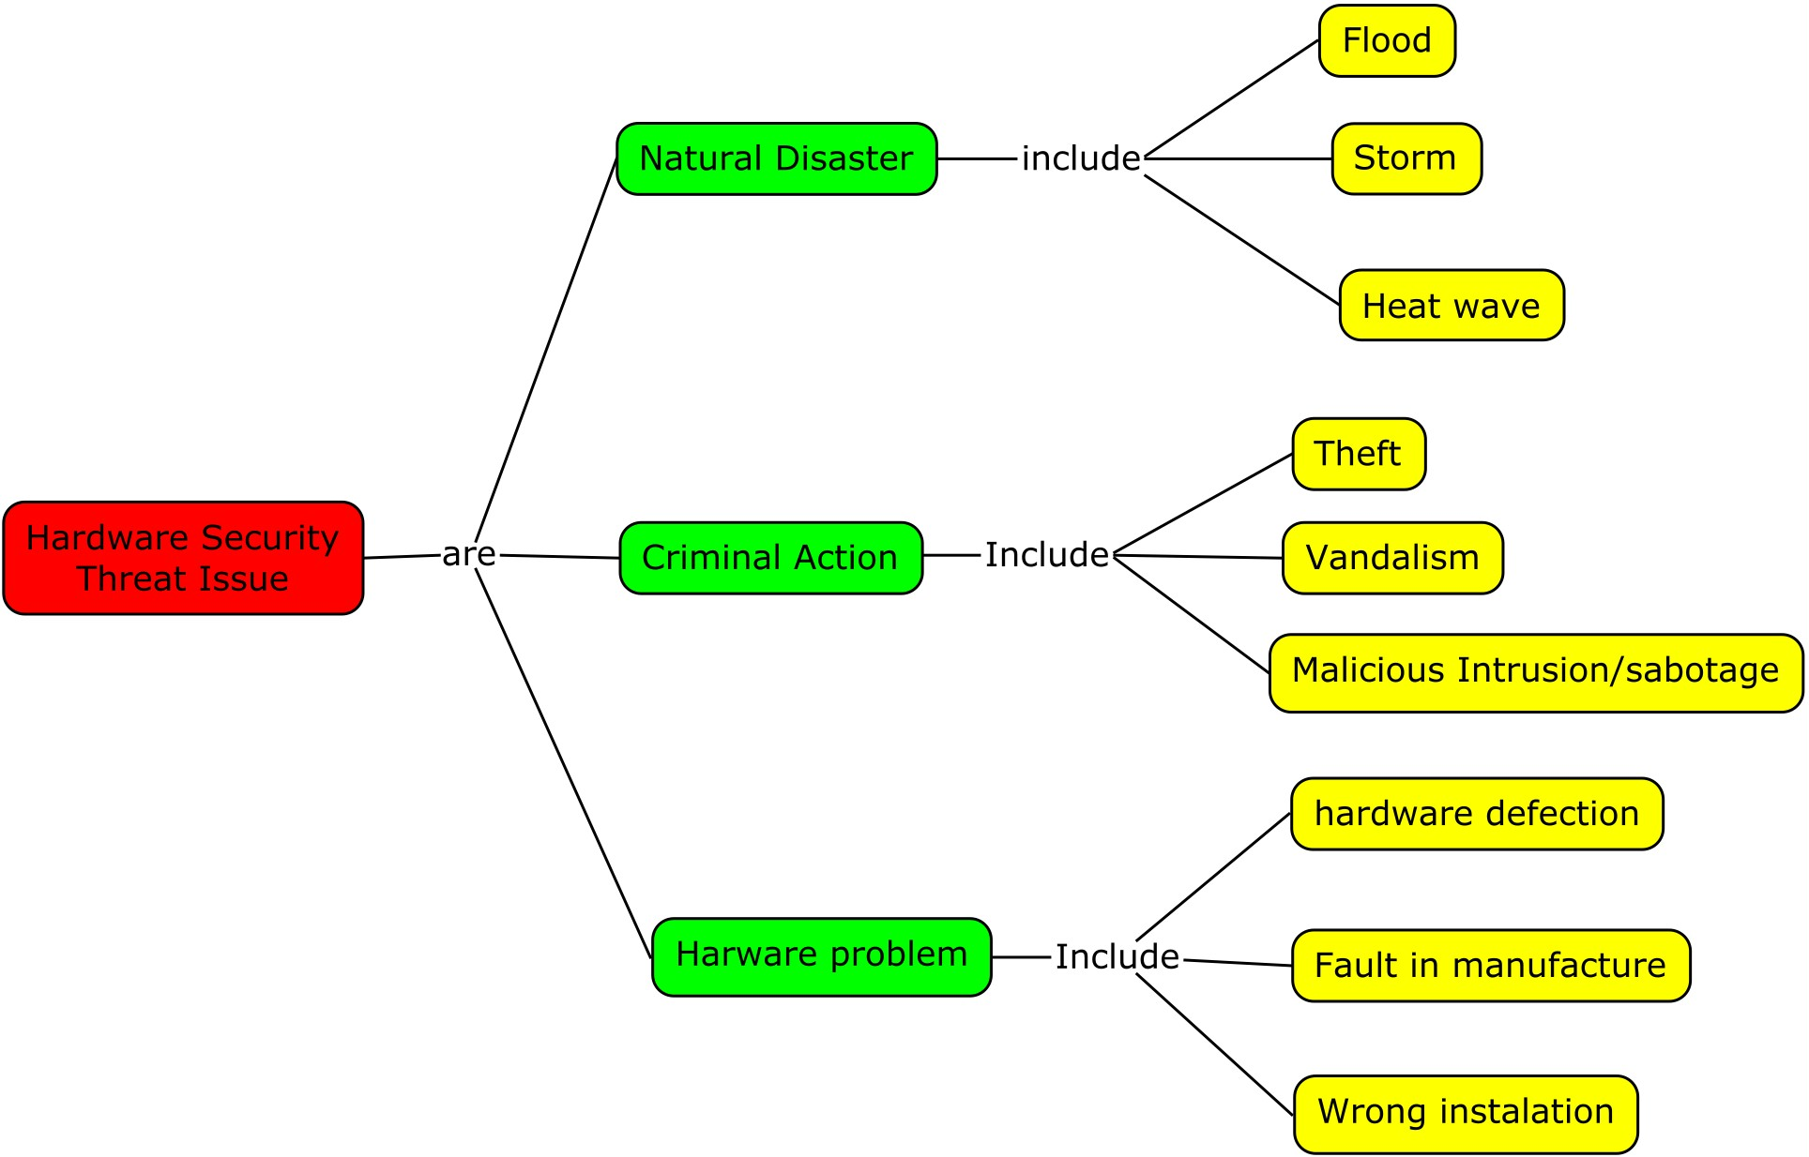
Hardware Security Threats
Hardware assets may require physical protection from various security threats. It may be necessary to ensure that hardware assets do not create or are not exposed to any environmental hazards. These controls additionally reduce the risk of unauthorized data access, unauthorized equipment removal, and disposal (Hingarh, V., & Arif, A. , 2013).

Slide 15
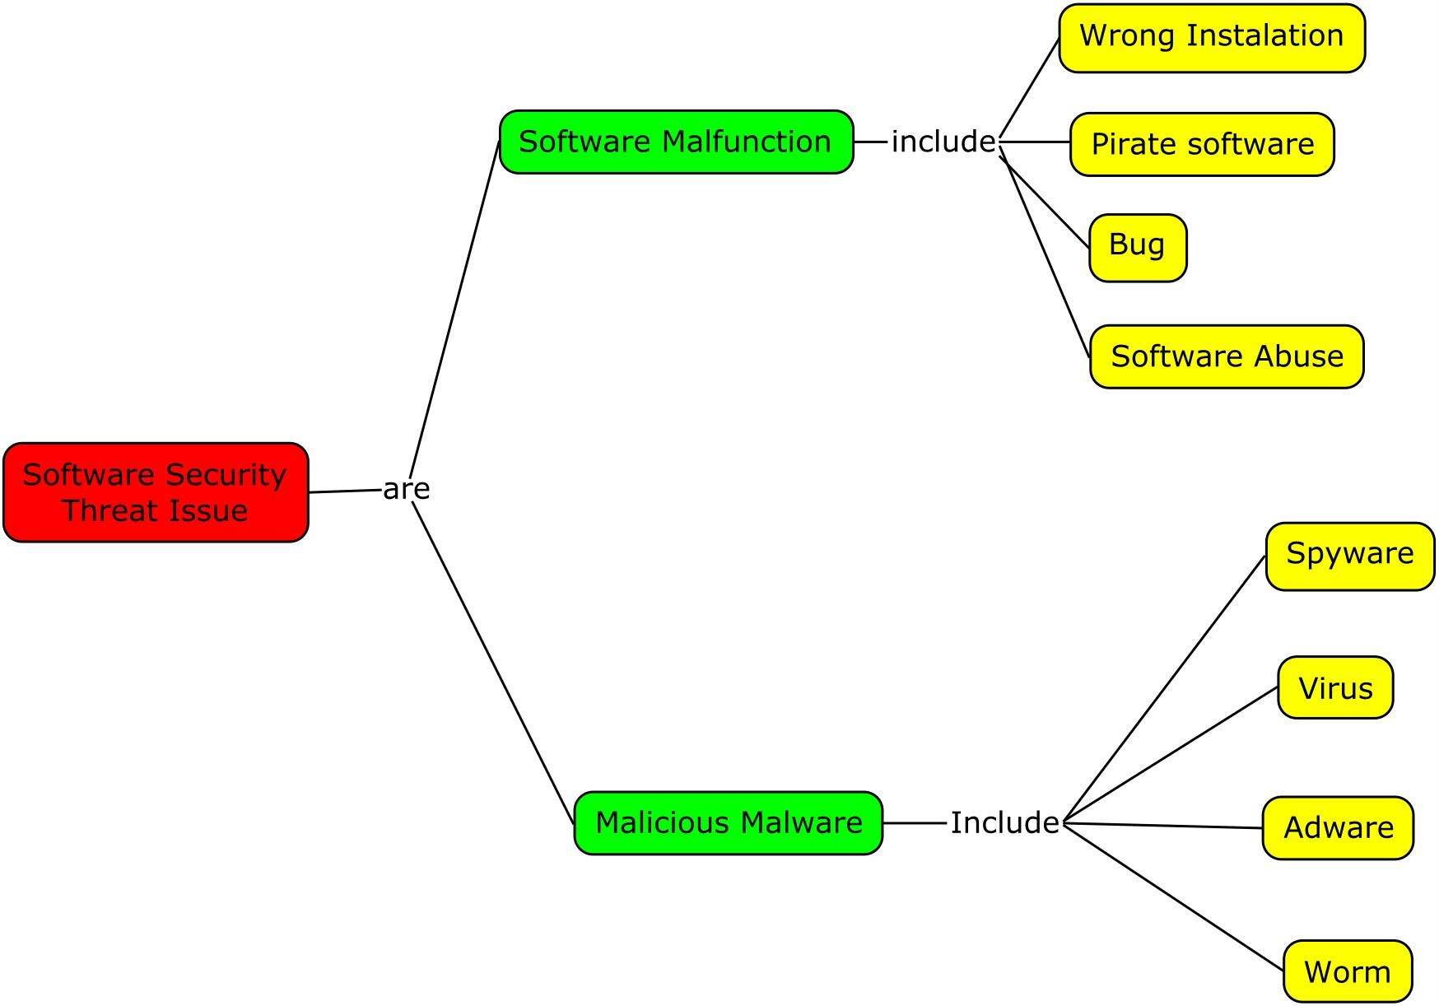
Software Security Threats
Software security is the idea of engineering software so that it continues to function correctly under malicious attack. Most technologists acknowledge this undertaking’s importance, but they need some help in understanding how to tackle Sametinger, J. , 2013).

Slide 16
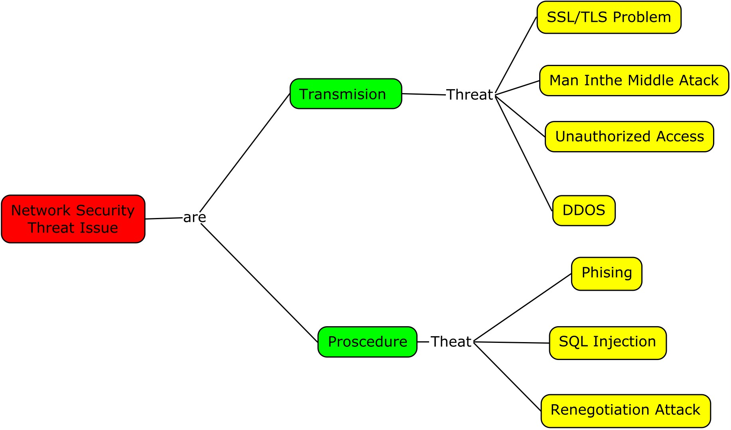
Network Security Threats
Networks present a host of issues for network managers. Unauthorized access points, broadcasted SSIDs, unknown stations, and spoofed MAC addresses are just a few of
the problems addressed in WLAN troubleshooting. Choi, M. K., Robles, R. J., Hong, C. H., & Kim, T. H. , 2008).

Slide 17
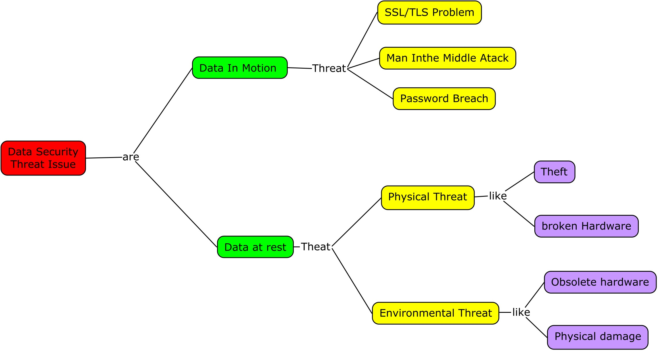
Data Security Threats
“Security data is important organizational information that is produced by performing a task in a business process and is important to the organization in terms of confidentiality, integrity, availability, or any combination of them” (D Bourgeois, 2014)

Slide 18
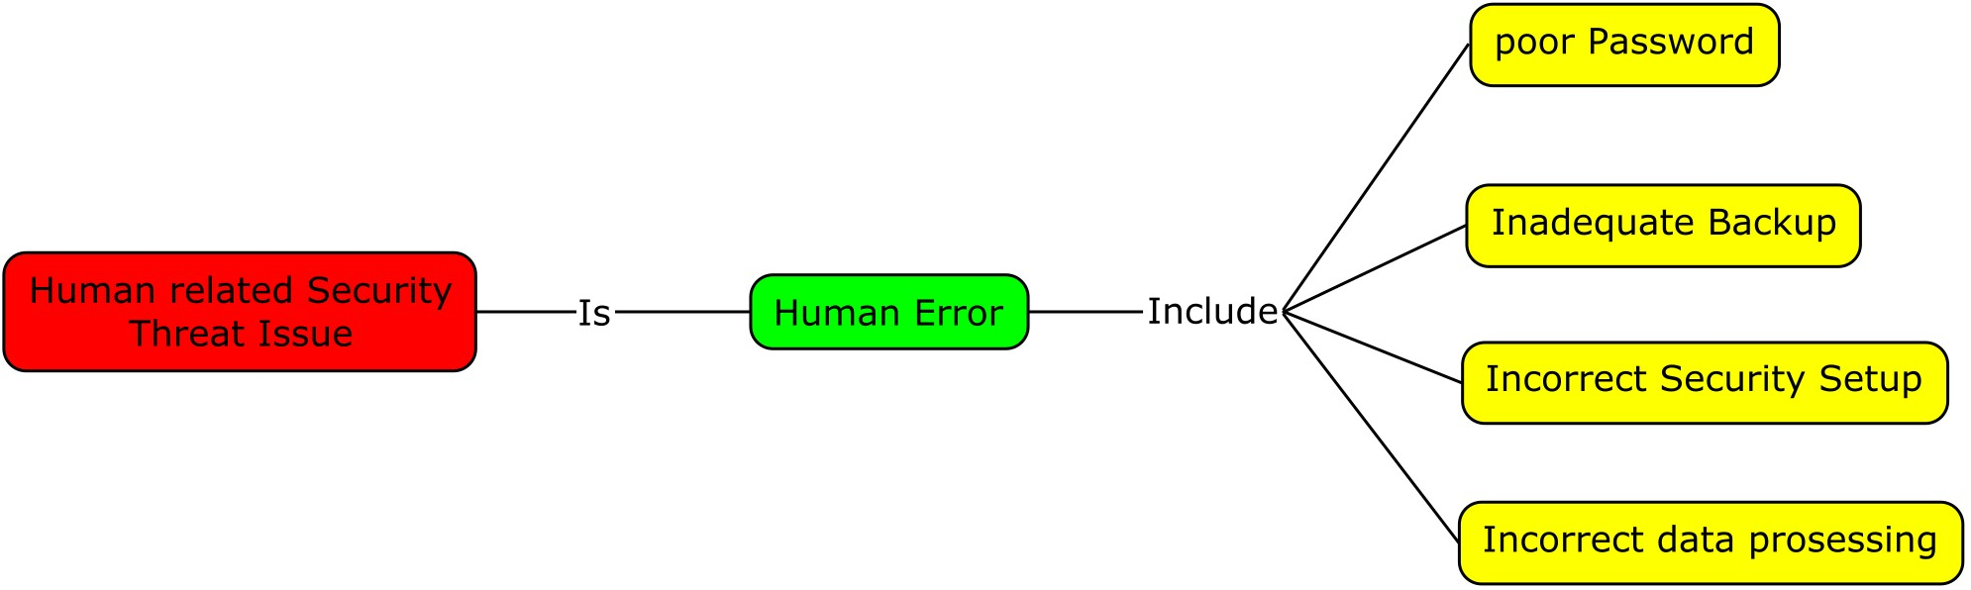
Human Related Threats
Against the backdrop of a complex and growing cyber threat landscape, where 57% of businesses now assume their IT security will become compromised, businesses are also waking up to the fact that one of the biggest chinks in their armor against cyberattack is their own employees. In fact, 52% of businesses admit that employees are their biggest weakness in IT security, with their careless actions putting business IT security strategy at risk (Kaspersky Lab, 2020)

Slide 19
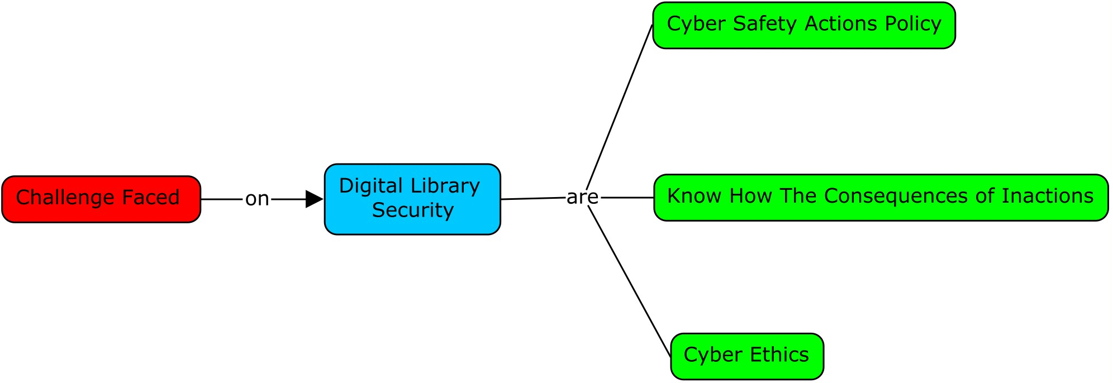
Challenge Faced on Digital Library Security
Challenge faced by Digital Library are Cyber Safety Actions Policy, Know How The Consequences of Inactions, Cyber Ethics (Adjie, 2019)

Slide 20
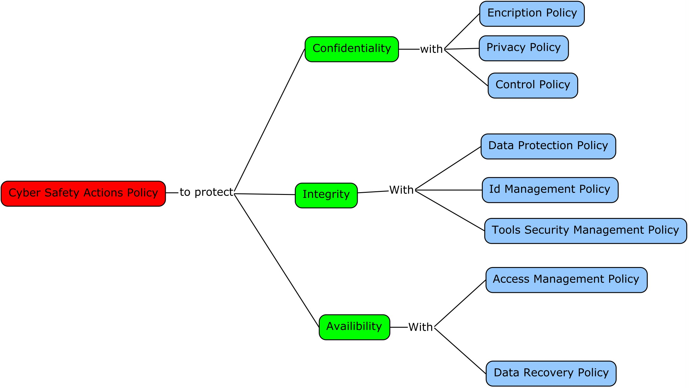
Cyber Safety Actions Policy
Cybersecurity policy also need strong legislations, to ensure legal certainty in the development of cyber security, the government enacts the cyber security national framework (Rizal, M., Yani, Y.M. , 2017)

Slide 21
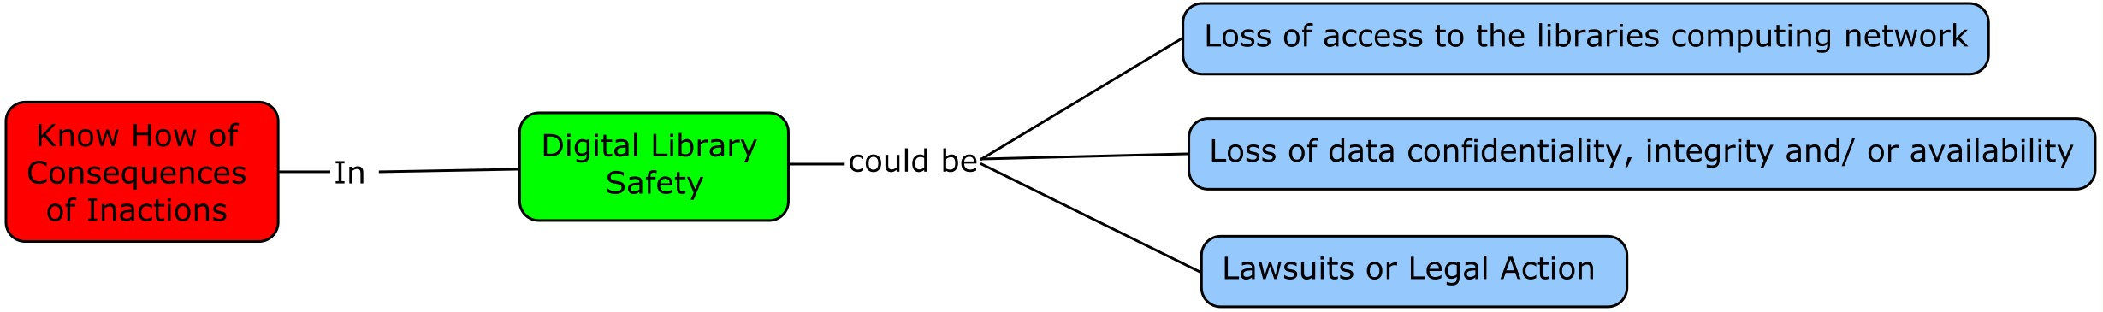
Know How The Consequences of Inactions
Know How The Consequences of Inactions is one of risk assessment to look for the damage and see the consequences what could be happend in the future regarding the process systems, security, protection systems and loss prevention programs. The Know How The Consequences of Inactions contribute to see the severity of damage when an incident occurs.

Slide 22
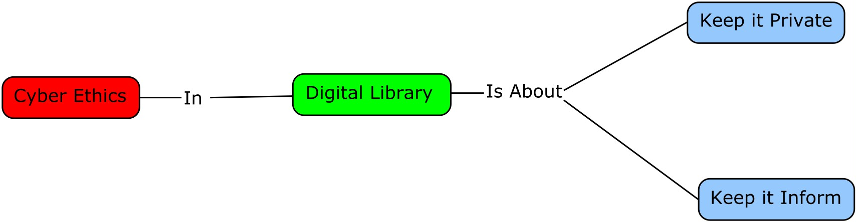
Cyber Ethics for Digital Library
Cyber Security is a matter of Contextual integrity to understanding privacy, both descriptively and normatively (Loi, M., & Christen, M. , 2020)

Slide 23
Conclusion
The 5S Digital library framework could also be use as a tool for doing risk assessment oh digital library security performance.
Digital Library as one of the entity of Cybersecurity continues to diverge into different paths, with each time evolved the security of the information.
The disruptive technologies create a new challenge to digital libraries with not only on how they secure their information resources, but how they require new platforms and intelligence to do so.

Slide 24
References
Bourgeois, D. (2014, February 28). Chapter 6: Information Systems Security. Retrieved November 12, 2020, from https://bus206.pressbooks.com/chapter/chapter-6-information-systems-security/
Choi, M. K., Robles, R. J., Hong, C. H., & Kim, T. H. (2008). Wireless network security: Vulnerabilities, threats and countermeasures. International Journal of Multimedia and Ubiquitous Engineering, 3(3), 77–86.
Hameli-Sendi, A. (2020). An efficient security data-driven approach for implementing risk assessment. Journal of Information Security and Applications, 54, 102593. doi:10.1016/j.jisa.2020.102593
Hingarh, V., & Arif, A. (2013). Understanding and Conducting Information Systems Auditing. John Wiley & Sone.
Kaspersky Lab. (2020). The Human Factor in IT Security: How Employees are Making Businesses Vulnerable from Within. Retrieved November 12, 2020, from https://www.kaspersky.com/blog/the-human-factor-in-it-security/
Knowles, A. (2019, March 04). Tough Challenges in Cybersecurity Ethics. Retrieved November 12, 2020, from https://securityintelligence.com/tough-challenges-cybersecurity-ethics/
Loi, M., & Christen, M. (2020). Ethical Frameworks for Cybersecurity. In M. Christen, B. Gordijn, & M. Loi (Eds.), The Ethics of Cybersecurity (pp. 73–95). Springer International Publishing. https://doi.org/10.1007/978-3-030-29053-5_4
Murthy, U., Gorton, D., Torrs, S., Goncalves, M., Fox, A., &amp; Delcambre, L. (2009, May). 5S Framework for Digital Libraries. Retrieved November 14, 2020, from http://dlrl.cc.vt.edu/projects/5S-Model/
Niblett, G. (2012). Threats and countermeasures. Itnow, 54(1), 6–9. https://doi.org/10.1093/itnow/bws002
Sametinger, J. (2013). Software security. Proceedings of the International Symposium and Workshop on Engineering of Computer Based Systems, 216. https://doi.org/10.1109/ECBS.2013.24

